Slide 1
Who Packed Your Amazon Order?
Have you ever wondered...
Ordered today --> delivered tomorrow!
Person or Robot?
Notes:
Raise your hand if you've ever ordered something from Amazon. How long did it take to arrive? Have you ever wondered who packed your order? Do you think it was a person, or maybe a robot? Pause for answers before moving on. This hooks students into the topic and creates curiosity.

Slide 2
Robots Are Everywhere!
VAC
Robot Vacuum
WHS
Warehouse Robot
Cleans your floors automatically
Picks and packs your orders
MED
Surgical Robot
MARS
Mars Rover
Assists doctors in the operating room
Explores another planet independently
Where have YOU seen robots?
Notes:
Take answers from students. Explain that robots are everywhere, even if they don't look like people. A Roomba is a robot. A self-checkout machine has robotic elements. Ask: What do all these robots have in common? (They follow instructions, sense the world, and act on it.)

Slide 3
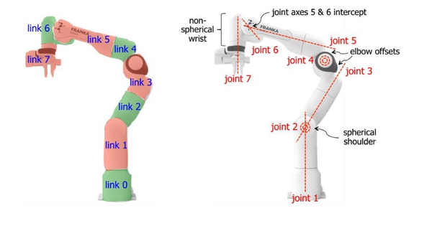
Meet the Robot!
Franka Emika Panda - a research and teaching robot arm
Gripper
Opens & closes
Wrist
Twists & tilts
Elbow
Bends & extends
Shoulder
Rotates 360°
What parts of YOUR body does this remind you of?
Notes:
This is the Franka Emika Panda — popular in research labs worldwide. Point out the joints: shoulder (base rotation), elbow (middle), wrist (end joint), gripper (fingers). Ask: What parts of your body does this remind you of? Robots have joints just like humans! Key insight: this robot has 7 degrees of freedom — just like your arm.

Slide 4
Your First Robotics Challenge
THE TASK:
Can you teach a robot this?
Cube A
Stack A on B!
Cube B
Place Cube A on top of Cube B
Sounds easy... right? (Spoiler: it is NOT.)
Notes:
Show the two cubes. Task: pick up Cube A and place it on top of Cube B. Ask 'Easy?' Everyone says yes. Then: 'Great — explain EVERY SINGLE STEP to the robot, like it has never seen a cube before.' Pause. Let them think. This sets up the next slide perfectly.

Slide 5
Turns Out It's Harder Than It Looks!
Every tiny step must be spelled out for the robot:
LOOK
1. Find the cube
ARM
2. Move the arm
OPEN
3. Open gripper
Camera locates it
Calculate angles
Spread fingers
DOWN
4. Move down
GRAB
5. Grab the cube
LIFT
6. Lift it up
Lower slowly
Apply right force
Check it held
MOVE
7. Move sideways
LOW
8. Lower again
DROP
9. Release!
Navigate to target
Align over cube
Open fingers gently
Your brain does all 9 steps automatically. Robots need every single one spelled out!
Notes:
Walk through each step slowly. What takes a human 2 seconds takes a robot 9 explicit steps — and each step has sub-steps. Humans skip details because our brains do them automatically — this is 'tacit knowledge.' Robots don't have tacit knowledge — they need precise instructions for everything. Ask: What other simple tasks might be harder than they look?

Slide 6
What If Something Changes?
Robots must handle the unexpected, just like people do!
What if... The cube moves?
What if... Someone bumps the table?
MOVE
BUMP
It slides 2 cm to the left.
Robot was aiming at empty air!
Everything shifts.
The robot's map is now wrong.
What if... Another robot interferes?
What if... The cube falls over?
BLOCK
FALL
Unexpected obstacle!
How should the robot react?
Now it's on its side.
Gripper position is all wrong.
This is called 'robustness' — one of robotics' hardest challenges!
Notes:
Ask: What could go wrong with our stacking task? Accept answers, then reveal these scenarios. Key concept: 'robustness' — a robot's ability to handle unexpected situations. Real robots constantly sense their environment and adapt. This is why robotics is such an interesting engineering challenge!

Slide 7
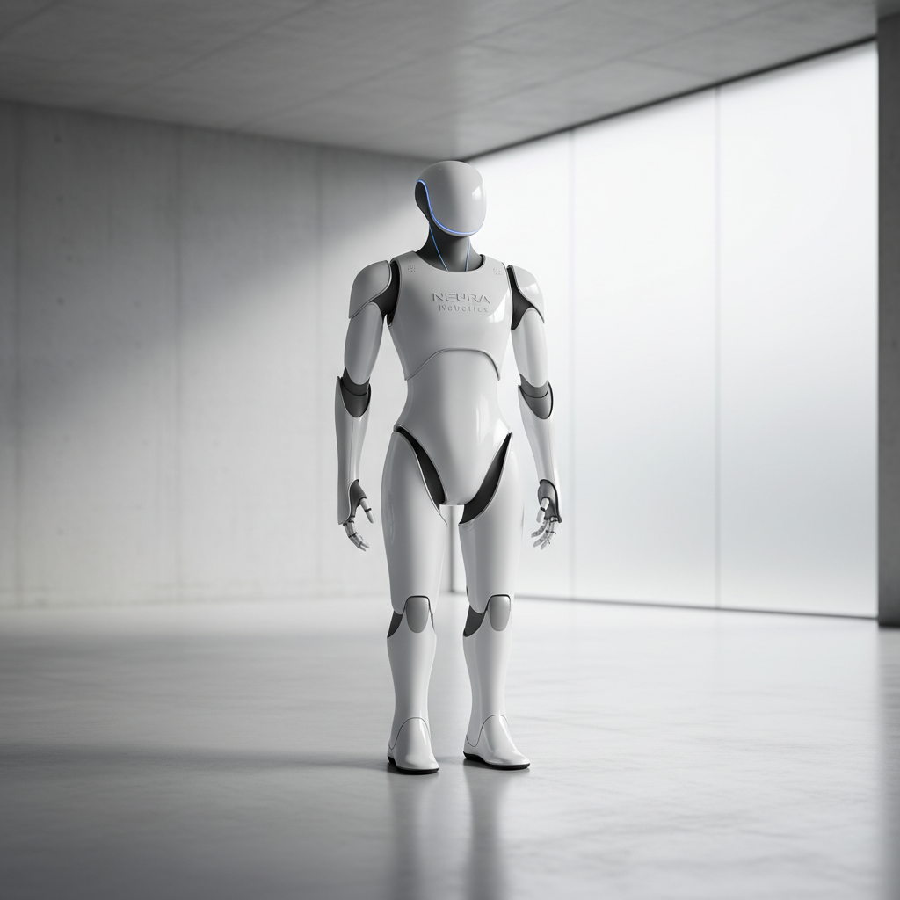
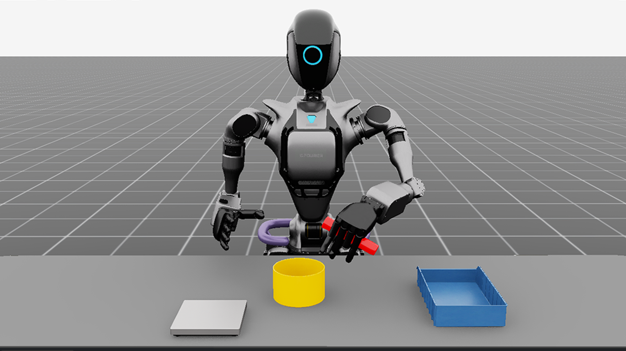
Would You Practice on a Million-Dollar Robot?
Option A -- Real Robot
Option B -- Simulation
VS
$1,000,000+
Cheaper, Free Sometimes!
Which would YOU choose?
Notes:
Ask students to vote by raising hands: A (real robot) or B (simulation). A real Franka Panda costs $30,000-$100,000 USD. Full system can exceed $1M. When students crash real robots: bent joints, broken sensors, expensive recalibration. That's exactly why simulation exists — the safe playground before the real thing.

Slide 8
Welcome to Simulation!
Real Robot
Genesis Simulation
REAL
SIM
-->
Very expensive
Free to use
Crashes = Damage
Crash & reset instantly
Setup takes hours
Run at 1000x speed
Needs maintenance
Try millions of tests
Practice without breaking anything!
Notes:
Compare simulation to a video game — when you die, you respawn. When a simulated robot crashes — restart! Key selling point: simulation lets you run the SAME task thousands of times overnight and collect data. Real robots would need months of real time. This is how AI for robots is actually trained today — in simulation.

Slide 9
Why Engineers Love Simulation
Safer
0 injuries
Faster
430,000x speed
SAFE
FAST
No one gets hurt when the robot crashes. Experiment without fear.
Run 430,000x faster than real time — a year of practice in 2 minutes!
Cheaper
$0 cost
Anywhere
Just a laptop
FREE
HOME
Genesis is completely free. No hardware, no lab, no maintenance bills.
All you need is a laptop. Use it at home, school, or anywhere.
This is how real companies train robot AI today: simulation first, then real world!
Notes:
Emphasize the 430,000x speed stat — it's mind-blowing. A year of training overnight! Companies like Boston Dynamics, Tesla (Optimus robot), and Google DeepMind all use simulation extensively. The 'sim-to-real gap' is a real challenge: making skills from simulation work on real hardware. That's an active area of research!

Slide 10
Your Turn!
If YOU were teaching a robot... what would you make it do?
FOLD
CUPS
SORT
COOK
Fold laundry
Stack cups
Sort candy
Cook noodles
BED
PET
TIDY
BOOK
Make the bed
Feed your dog
Clean the room
Sort books
Pick your idea and describe step 1!
Notes:
Take student answers! Let them get creative. Write the most interesting ones on the board. Drill down on ONE suggestion: 'OK, you said fold laundry — what's the very FIRST step? Pick up the shirt? But HOW does the robot know where the shirt is? How does it know it's a shirt and not a sock?' Encourage wildest ideas — that's how real robotics research starts!

